Slide 1
The restriction mapping problem revisited
Gopal Pandurangan and H. Ramesh
Journal of Computer and System Sciences 526~544(2002)

Slide 2
Abstract-1
In computational molecular biology, the aim of restriction mapping is to locate the restriction sites of a given enzyme on a DNA molecule. Double digest and partial digest are two well-studied techniques for restriction mapping. While double digest is NP-complete, there is no known polynomial-time algorithm for partial digest. Another disadvantage of the above techniques is that there can be multiple solutions for reconstruction.

Slide 3
Abstract-2
In this paper, we study a simple technique called labeled partial digest for restriction mapping. We give a fast polynomial time (O(n² log n) worst-case) algorithm for finding all the n sites of a DNA molecule using this technique. An important advantage of the algorithm is the unique reconstruction of the DNA molecule from the digest. The technique is also robust in handling errors in fragment lengths which arises in the laboratory. We give a robust O(n⁴) worst-case algorithm that can provably tolerate an absolute error of (where is the minimum inter-site distance), while giving a unique reconstruction. We test our theoretical results by simulating the performance of the algorithm on a real DNA molecule.

Slide 4
Abstract-3
Motivated by the similarity to the labeled partial digest problem, we address a related problem of interest––the de novo peptide sequencing problem (ACM-SIAM Symposium on Discrete Algorithms (SODA), 2000, pp. 389–398), which arises in the reconstruction of the peptide sequence of a protein molecule. We give a simple and efficient algorithm for the problem without using dynamic programming. The algorithm runs in time O(k log k), where k is the number of ions and is an improvement over the algorithm in Chen et al.

Slide 5
Partial digest problem
Also called turnpike reconstruction problem.
reconstruct a set of n points (restriction sites) on a line given the set of (n,2) distance (fragment) between them.
Possible solutions between 1/2n^{0.8107144} and 1/2n^{1.2324827}
Fragment length could be with error in laboratory

Slide 6
Labeled partial digest
Label both ends of the DNA molecule
Primary fragments : fragments have one endpoint
Others are called secondary fragments
Complementary pair: c_{i} =(x_{i}, y_{i}), x_{i}<= y_{i} ,x_{i} + y_{i} =t, where t is the length of parent fragment

Slide 7
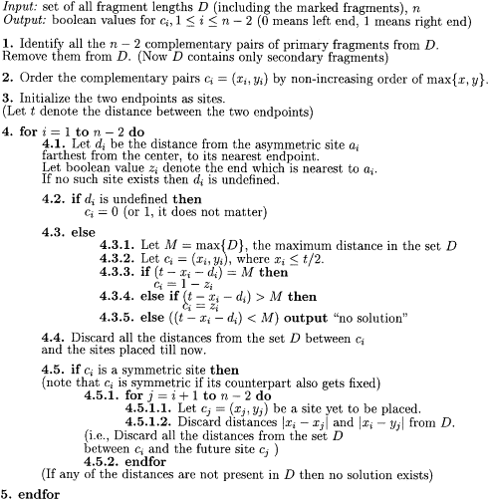
An algorithm for error-free labeled partial digest

Slide 8
Running Time
Step 1 takes O(n²) time as it involves scanning O(n²) fragments and determining the ones that are labeled
Step 2 can be done in O(n log n) time by sorting
Steps 4.1, 4.2, 4.3.1 involve operations of searching, deleting and finding a maximum in a set of size O(n²)
Steps 4.4 and 4.5 involve O(n) delete operations per round. Each operation can be implemented in
O(log n) time (by a balanced binary tree) and there are a total of O(n²) search and delete operations (O(n) per loop), and there are a total of O(n) find-max operations

Slide 9
Tolerating errors in fragment lengths
Fragment length lies in an interval [f-e,f+e]
Let Δdenote the minimum inter-site distance, technique is robust in tolerating an absolute error up to e= Δ /(6n+2)
a complementary pair if and only if f1+f2 lies in [t-3e,t+3e] the (open) interval .

Slide 10
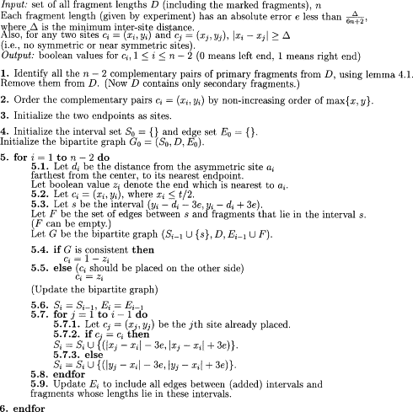
Robust labeled partial digest algorithm

Slide 11
The de novo peptide sequencing problem
The de novo peptide sequencing problem is the reconstruction of the peptide sequence from a given tandem mass spectral data
a peptide (R1-R2-R3) leads to the following prefix ions (also called as b-ions): (R1)+,(R1-R2)+ and (R1-R2-R3)+ and to the following suffix ions (also called as y-ions): (R1-R2-R3)+, (R2-R3)+ and (R3)+

Slide 12
The de novo peptide sequencing problem (continue)
1. it is unknown whether a mass peak of some ion corresponds to a prefix or suffix sequence
2. some ions may be lost in experiments and the corresponding mass peaks disappear in the spectrum

Slide 13
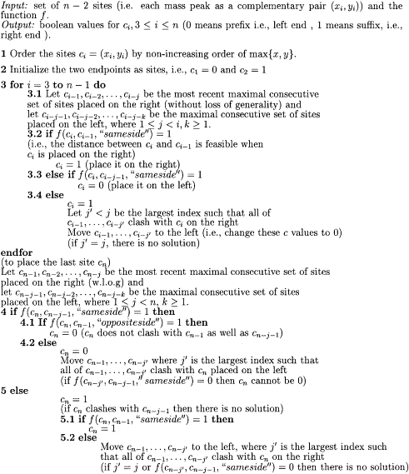
Algorithm for peptide sequencing

Slide 14
Running Time
Determining feasibility between a pair of sites takes O(1) time since we have precomputed the mass array
Step 1 takes O(k log k) time2 due to sorting
Steps 3 and 4 can be implemented in O(k) time by noting that each site is handled at most twice

Slide 15
two important open problems in the partial digest approach
Suppose there are multiple copies of each fragment, i.e., different numbers of copies for different fragment, then our algorithm as stated above does not work. (This also includes the possibility of distances being lost––missing fragments).
the status of the partial digest problem is still unresolved. It is strongly suspected that there is a polynomial time algorithm

